Slide 1


Making Your Lectures More
Accessible to Students Using
English as a Second Language
Anneli.Williams@glasgow.ac.uk
Rachel.Elmslie@glasgow.ac.uk

Slide 2
Aims
Achieve a better understanding of:
listening skills NNS students are likely to have on arrival
NNS students’ experience of listening in lectures
techniques for making lecture content more accessible

Slide 3
Listening competence on arrival
IELTS Band 6 ‘Competent user’
The test taker has an effective command of the language despite some inaccuracies, inappropriate usage and misunderstandings. They can use and understand fairly complex language, particularly in familiar situations.
IELTS Band 7 Good user
The test taker has operational command of the language, though with occasional inaccuracies, inappropriate usage and misunderstandings in some situations. They generally handle complex language well and understand detailed reasoning.
https://www.ielts.org

Slide 4
The IELTS listening test format
30 minutes in total
4 listening passages (c 5-8 mins each)
40 questions (T/F/NG, MCQs, short answer, sentence completion, labelling a diagram)
https://www.ielts.org

Slide 5
How students prepare for IELTS
“A common error is for students to answer the wrong question or simply not following the instructions laid out before them. They need to learn to read instructions and questions clearly and follow those closely.”
https://manwrites.com/the-teachers-guide-to-the-ielts-listening-test/
“IELTS will add lost of information but you only need to listen for answers. Keep yourself focussing on listening for answers to questions.”
https://ieltsliz.com

Slide 6
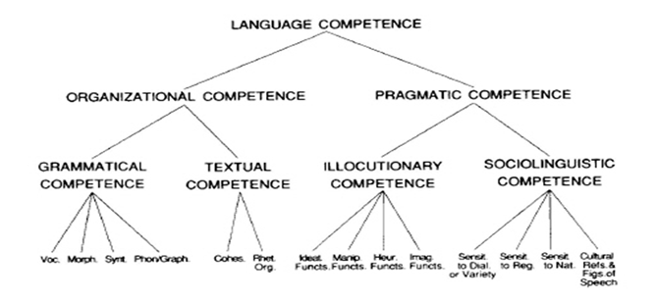
Language proficiency
Bachman and Palmer, 1996

Slide 7
Benefits of rethinking your approach to communication
Engage your learners
Get more of your content across – key concepts & disciplinary terminology
Model effective communication for a multicultural/multilingual environment
Facilitate NNS learners’ continuing acquisition of English

Slide 8
Listen & notice…
What makes the extract difficult to understand
How the experience makes you feel
How the experience affects your thinking
How the experience affects your behaviour
How would you respond if I asked you “Does anyone have any questions?”

Slide 9
Sources of difficulty
Language
Explicitness
Organisation
Context
Content
Multitasking/multimodality

Slide 10
Language
Speech rate
Lack of pauses between idea units
Unfamiliar accent
Use of less frequent vocabulary
Grammatical complexity
Embedded idea units
Complex pronoun reference
Acoustic blurring in natural speech
    Eg. ‘How to recognise speech’
    ‘How to wreck a nice beach’

Slide 11
Explicitness
Implicit ideas
Lack of redundancy
Organization
Events narrated out of natural time order
Examples preceding the points they illustrate
Context
Lack of visual or other support

Slide 12
Content
Unfamiliar topics
Number of things, people & concepts referred to
Unclear indication of the relative importance of ideas, information or protagonists
Abstract content
Multitasking
Simultaneous listening + reading + writing
Typed vs handwritten notes
(Lynch. 2009)

Slide 13
Now consider
What would be the most effective preparation for the student to undertake prior to the lecture?
What could the lecturer do differently during the lecture?
What would be useful to have in place for the student after the lecture?

Slide 14
Before the lecture
Provide clear, concise information about the topic & purpose of the lecture/seminar - ILOs
Make PPT slides available in good time
Provide key word lists (or highlight key words in your PPT)
Annotate reading lists
Help learners habituate to your voice and style of delivery eg via 2-3 minute online ‘trailers’
Encourage (appropriate) collaboration
Invite learners to post questions they’d like to explore (anon)
Develop your ability to modulate your speech by interacting with your learners

Slide 15
During the lecture
Make the purpose of your talk (and each section) clear
Ensure the organisation is straightforward
Signal relative importance of ideas & information
Illustrate concepts with examples familiar to your audience
Use visuals along with words
Concept check – or better still, pause periodically for students to concept check amongst themselves & ‘recalibrate’
  You need to understand it and express it in your own words, not just by copying the professor’s words. What the professor teaches just helps me understand certain things or certain methodology on the subject, so I guess the only way to get good grades is for me to understand everything, to understand all the knowledge I’m being given and explain in my own words.

Slide 16
I don’t think the recorded lectures are helping. Many of them are recorded badly and we can’t understand the content [accent, sound quality, audio is out of sync with slides]. Then we go to live Q&A sessions which takes only 1 hour but if we don’t understand the lectures how can we make questions?
PGT student

Slide 17
After the lecture
Don’t just provide training on tools (eg zoom recordings) – but also on how to use the tools for learning
Make a recording and transcript of your lecture available (but don’t be too surprised if students don’t use them…)
Encourage students to share & discuss notes with a study partner – provide questions/ brief follow-up tasks linked to your session ILOs to focus the discussion
Provide opportunity to apply learning to a relevant context and share with people from other backgrounds (including yourself)
Suggest follow-up reading

Slide 18
References
Bachman, L. & A. Palmer (1996) Language Testing in Practice. Oxford: Oxford University Press.
Chang, A. C.-S., & Read, J. (2006). The effects of listening support on the listening performance of EFL learners. TESOL Quarterly, 40, 375-397.
Field, J. (2011). Into the mind of the academic listener. ELT Journal, 10/2, 102-112.
IELTS (2019) How IELTS is scored [online]. IELTS [Viewed 6 Jan 2020]. Available from: https://www.ielts.org/about-the-test/how-ielts-is-scored
Lynch, T. (2009). Teaching Second Language Listening. Oxford: Oxford University Press.
Lynch, T. (2011). Academic listening in the 21st century: Reviewing a decade of research. ELT Journal, 10/2, 79-88.
Morrison, B. (2019). Stories of autonomy: international students successfully surviving, striving and thriving in a second-language ecosystem. Ed D Dissertation, University of Glasgow.

